Slide 1
EEL 4436C/5437C Microwave Engineering
Prof. Xun Gong
Lecture 2 – Transmission Line

Slide 2
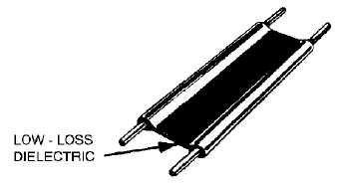
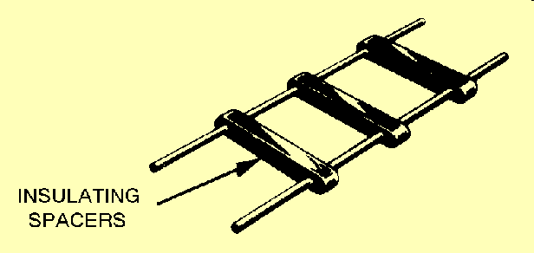
Two-Wire Line
Wire radius = a
Wire spacing = S
a<<S
Z₀ > 100Ω
Z₀ ~ 300Ω
Used mostly in TV applications to connect to “Rabbit-Ear” dipole antenna
Suffers from radiation Loss at f > 300 MHz

Slide 3
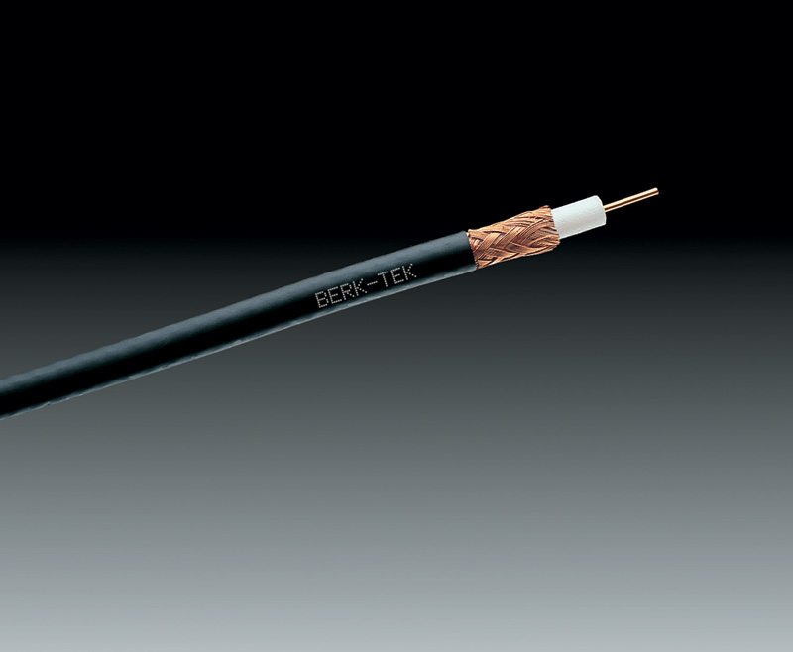
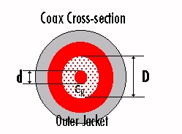
Coax Line
Z₀=75Ω (TV)
Z₀=50Ω (RF/MW system)
The most common T. Line for connecting components. Have virtually replaced waveguide except for high-power (>1 KW) applications

Slide 4
Why 50 Ohm?
1.5
1.4
attenuation is lowest at 77 ohms
1.3
1.2
50 ohm standard
1.1
1.0
normalized values
0.9
0.8
0.7
power handling capacity peaks at 30 ohms
0.6
0.5
10
20
30
40
50
60
70
80
90
100
characteristic impedance
for coaxial airlines (ohms)

Slide 5
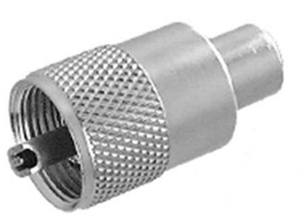
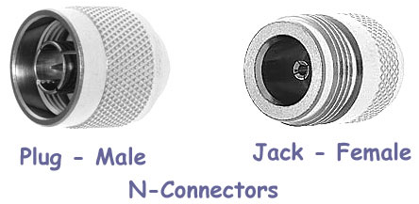
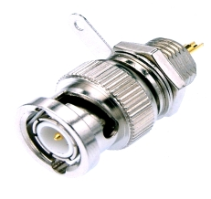
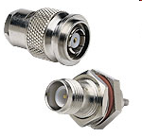
Coax Connector
< 100 MHz (UHF: 30-300 MHz)
Cheap but outdated
UHF
Mode free up 18 GHz
Slot in outer conductor < 12 GHz
Mode free up to 18 GHz
Practically used up to 3-4 GHz
BNC
Improved from BNC
Practically used up to 11-12 GHz
Some can go up to 18 GHz
TNC

Slide 6
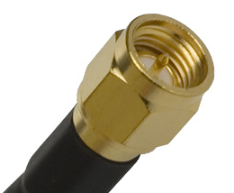
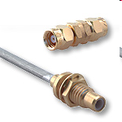
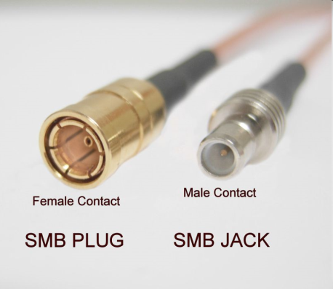
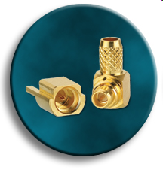
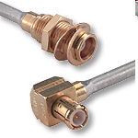
Coax Connector
With semi-rigid cable up to 18 GHz
Otherwise < 12 GHz
Torque wrench required (5 in-lb)
SMA
Smaller and cheaper than SMA
Work up to 10 GHz
SMC
Push on and off
Work up to 4 GHz
For wireless, GPS, cell phone
Very small, snap on/off
Work up to 6 GHz
MCX
MMCX

Slide 7
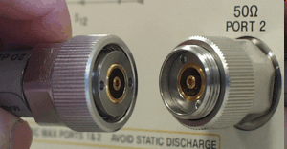
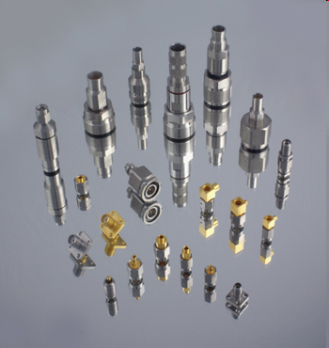
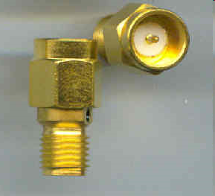
Instrument Connector
APC7
For repeated connections
Up to 18 GHz
Torque wrench required (12 in-lb)
3.5mm (<26.5 GHz)
2.92 mm or K connector (<40 GHz)
2.4mm (<50 GHz)
1.85 mm or V connector (<65 GHz)
1.0 mm (< 110GHz)
All air dielectric, torque of 8 in-lb except for 1.0 mm (3 in-lb)
3.5mm, 2.92 mm, and SMA are physically compatible. But SMA quality is not that good. So you need a connector saver!

Slide 8
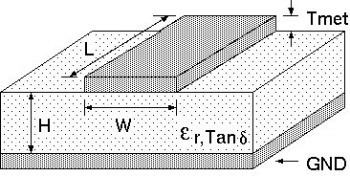
Microstrip Line
Wide Lines -> Large C/Unit Length-> Low impedance
Narrow Lines -> Small C/Unit Length-> High impedance
Wide Lines -> Small Resistance -> Low Loss
Narrow Lines -> Large Resistance -> High Loss
Wide Lines -> fields mostly in dielectric -> (ε_{eff} -> ε_{r})
Narrow Lines -> a lot of fields in air -> (ε_{eff} -> (ε_{r}+1)/2)
Analytic formulas for calculating ε_{eff} , Z₀ are in Pozar’s book

Slide 9
Microstrip Line
H < λ_{g}/15 before radiation occurs in the substrate
Typical H (λ_{g}/30 to λ_{g}/15)
Less H -> less W for the same Z₀
Reduce circuit size but induce more loss
In RF applications, H ~ λ_{g}/100 to result in compact circuits

Slide 10
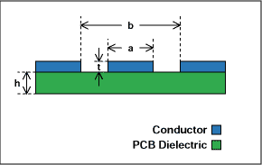
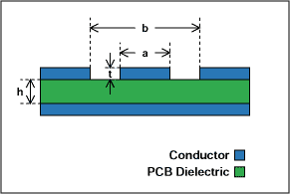
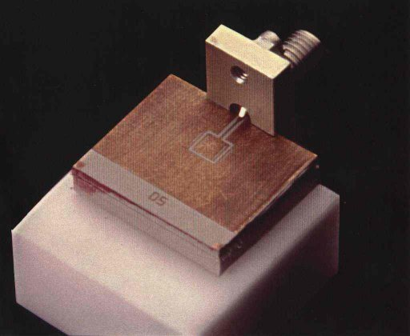
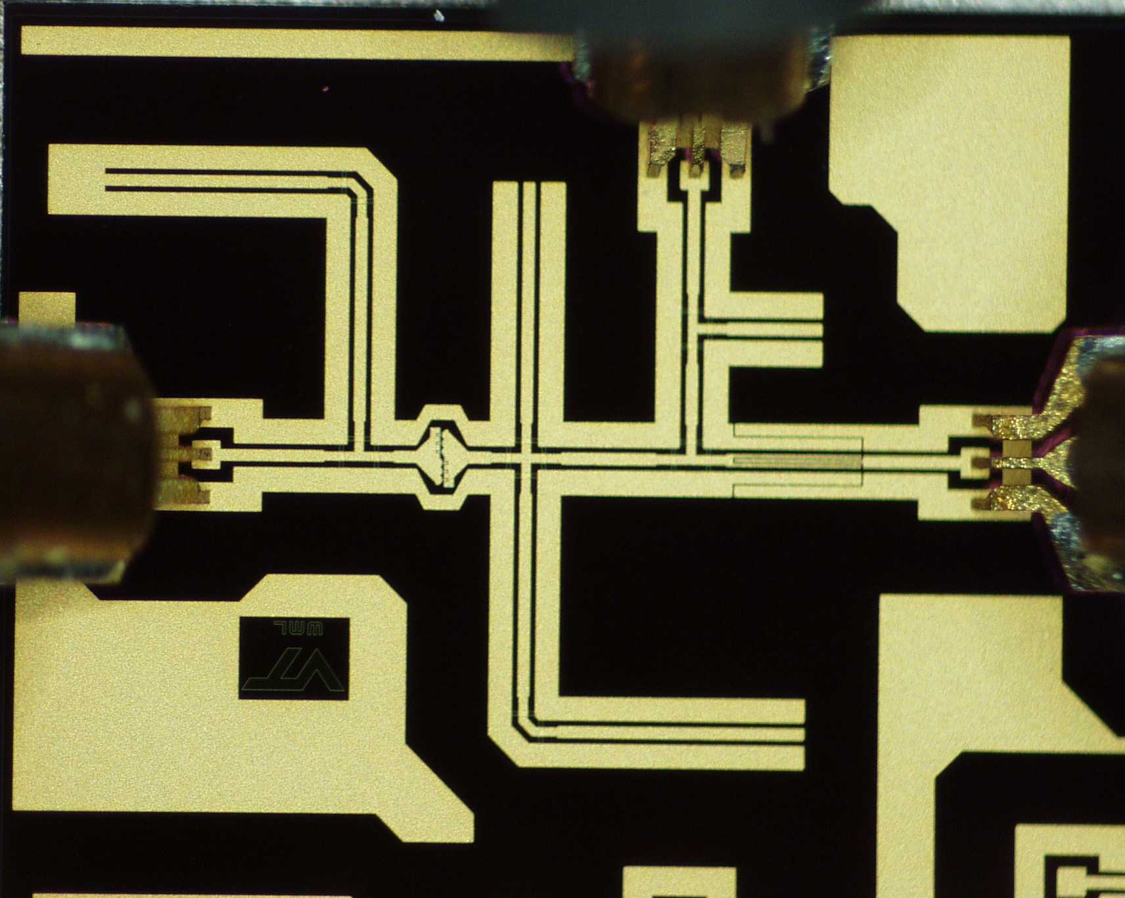
Coplanar Waveguide
CPW without Ground Plane
CPW with Ground Plane
Coax-CPW Transition
CPW based Mixer

Slide 11
Coplanar Waveguide
Larger a -> Lower impedance
Larger b-a (larger gap) -> Higher impedance
Larger h -> The less dependence of Z₀ on h
Larger ε -> Lower impedance
Use ADS LineCal to calculate all the properties of CPW

Slide 12
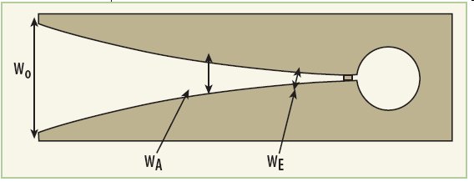
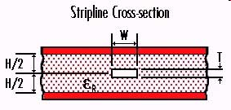
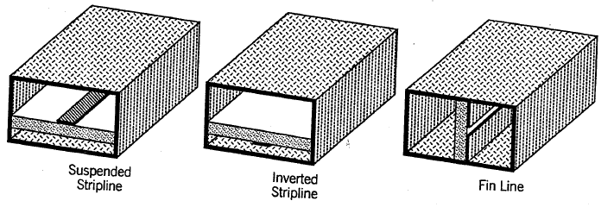
Other T. Lines
Slot Line for Vivaldi Antenna
Strip Line (TEM)
No radiation loss, for millimeter-wave applications

Slide 13
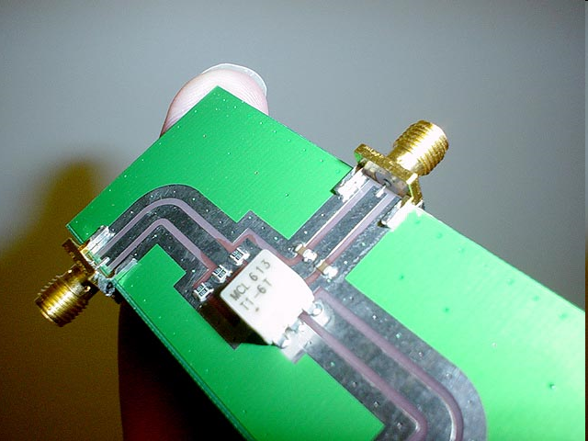
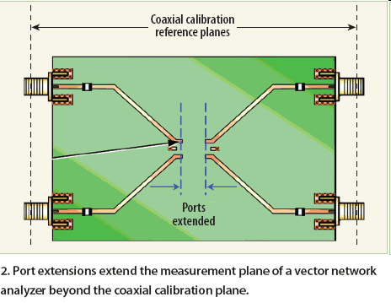
Transitions
SMA to CPW Transition
SMA to Microstrip Transition

Slide 14
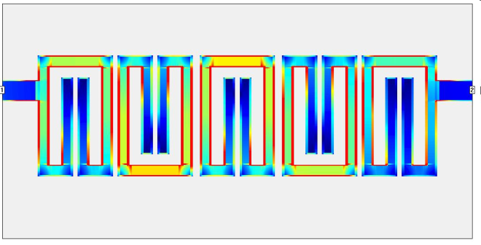
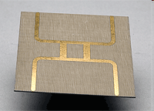
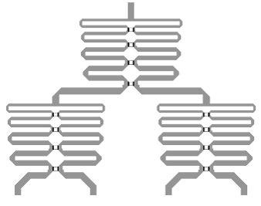
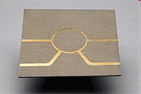
T. Line Components
Five-Pole (Resonator) Hairpin Filter
Branch line Hybrid
4-Way Power Combiner/Splitter
Ring (Rat Race) Hybrid

Slide 15
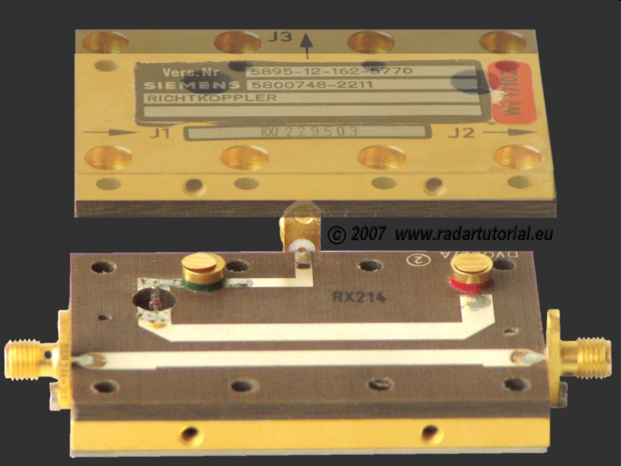
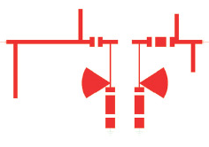
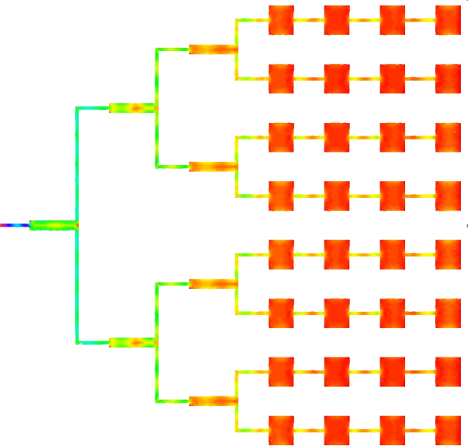
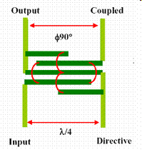
T. Line Component
Microwave Amplifier with Bias & Matching Networks
Directional Coupler
Lange Coupler
Patch Antenna Array

Slide 16
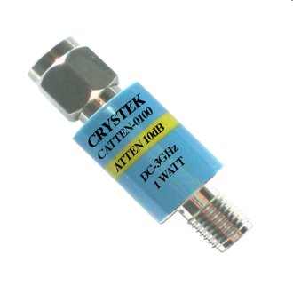
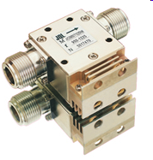

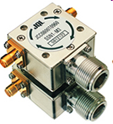
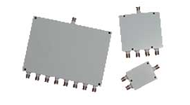
T. Line Component
Attenuate signals to protect instruments
Attenuator
Ferrite-based device, one-way traffic
Isolator
Block DC, Pass RF
Ferrite-based 3-port device
DC Block
Circulator
Power Divider/Combiner

